Slide 1
A Detailed Look into Belarus Used Car Market
By : Team Pattern 6
Kartik Jain
Aasish Kumar
Aihan Liu
Ali Can Mutlu
Kurtis Shen

Slide 2

Agenda
Introducing the Topic
Modeling
Data Transformation
Previously
Data Pre-Processing
SMART Questions
EDA
Showcasing the Graphs
Normalization
Outlier Checking
Results

Slide 3
Research Proposal
What factors determine the prices of cars in the used car market?
Manufacturer Name?
Color?
Engine Capacity?
Odometer Value?
Engine Type?
Year Produced?

Slide 4
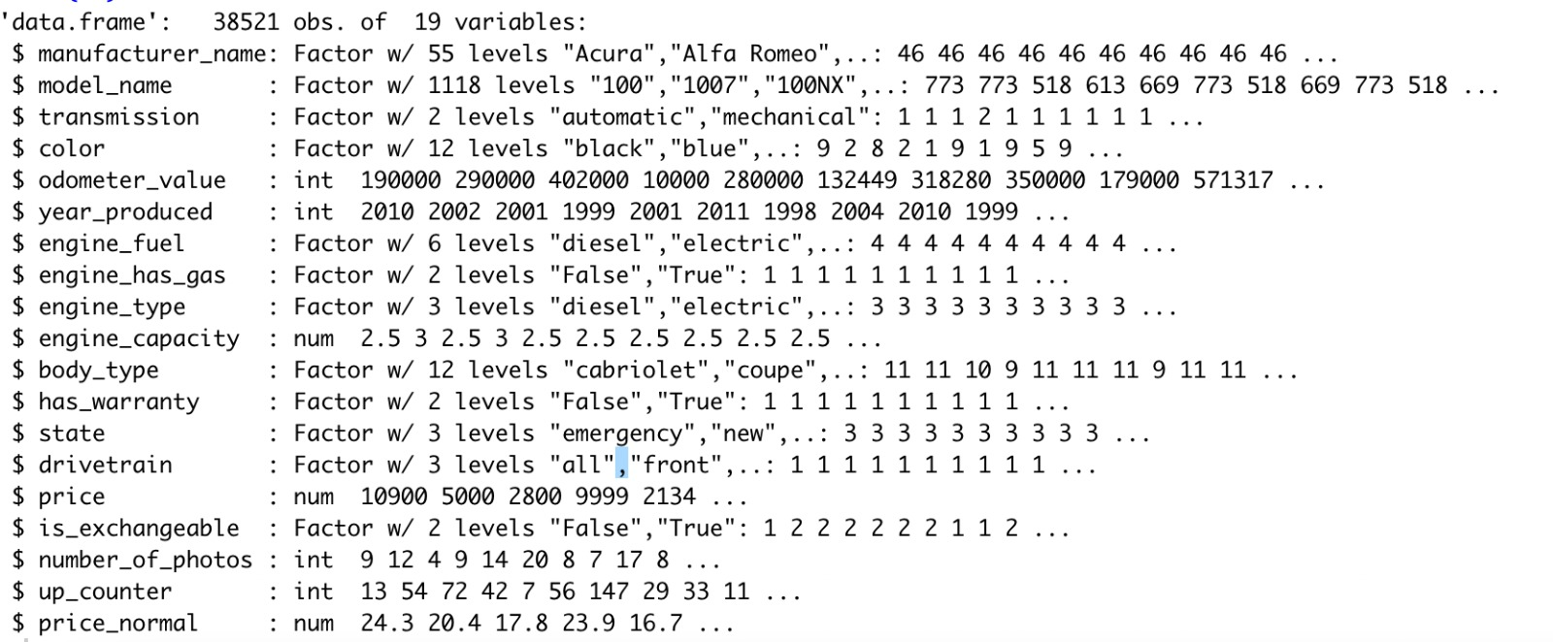
Data Set Information
Used car catalog for Belarus for the year 2019
Source: Kaggle
No. Observations: 38521
No. of variables: 19
MeanPrice: 6639.97$
Std.DevPrice=6428.15$

Slide 5
Data Pre-Processing
Dropping Null Values : engine_capacity(10)
Factor Checking
Name Change: Price USD – Price

Slide 6
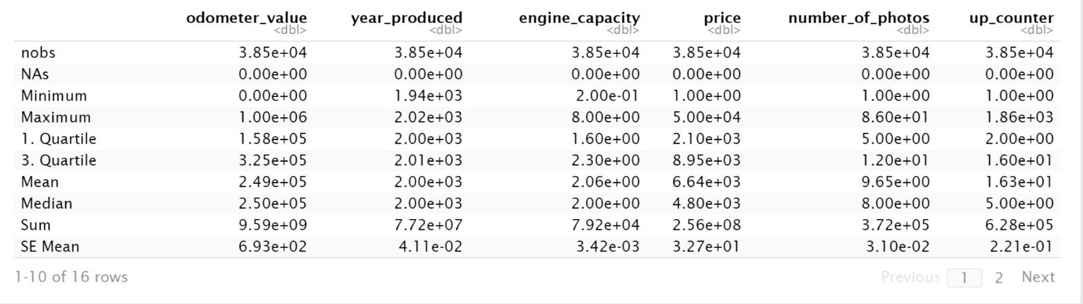
Descriptive – Basic Statistics for the Variables

Slide 7
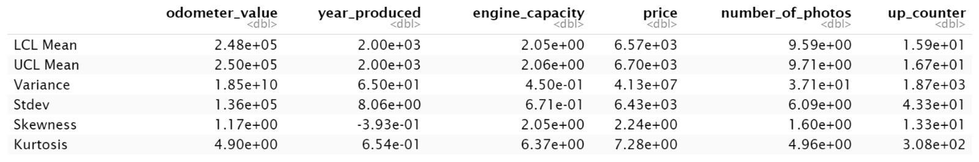
Descriptive – Basic Statistics for the Variables
Notes:
Highlight Standard Deviation

Slide 8
SMART QUESTIONS

Slide 9
SPECIFIC
Is it possible to build a model to find a relationship between car prices by looking at different factors that include numerical, categorical values and further use the model to predict car prices?

Slide 10
Measurable
Is it possible to measure metrics such as r-square, MAE, MSE and RMSE with the data set categories in towards coming up with a model?

Slide 11
Achievable
Based on the preliminary analysis that the team concluded is it possible to find a pattern between target variable(car price) and the independent variable?

Slide 12
Relevant
Can the research help the sellers and buyers in the used car market to make an informed decision about the price of the vehicle?

Slide 13
Exploratory Data Analysis

Slide 14
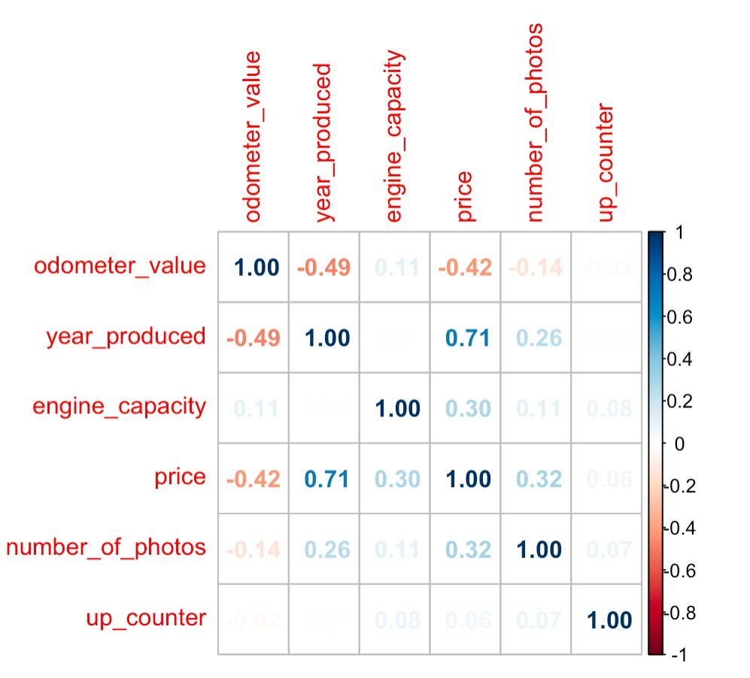
Correlation Plot

Slide 15
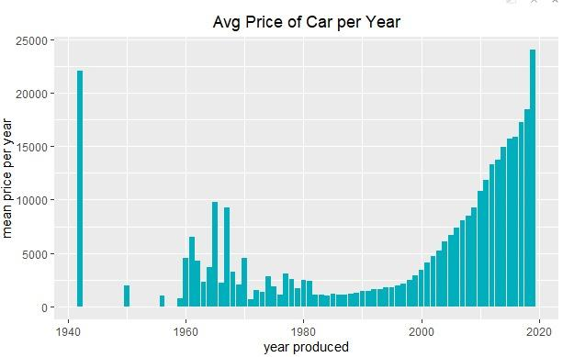
Mean Price of Car vs Year Made – Do you see anything interesting?
Notes:
Add an arrow to the left side

Slide 16
What was the story?
year_produced
Manufacture_name
odometer_value
color
transmission
engine_type
engine_capacity
body_type
Price

Slide 17
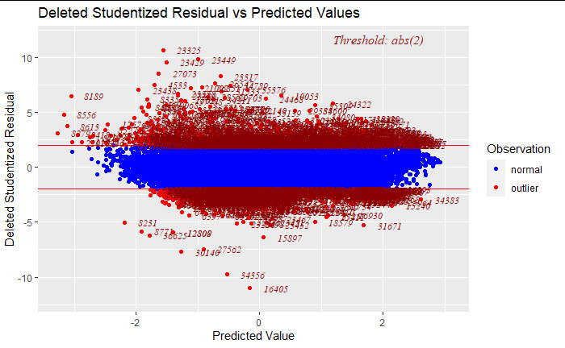
Outlier Checking for Target Variable

Slide 18
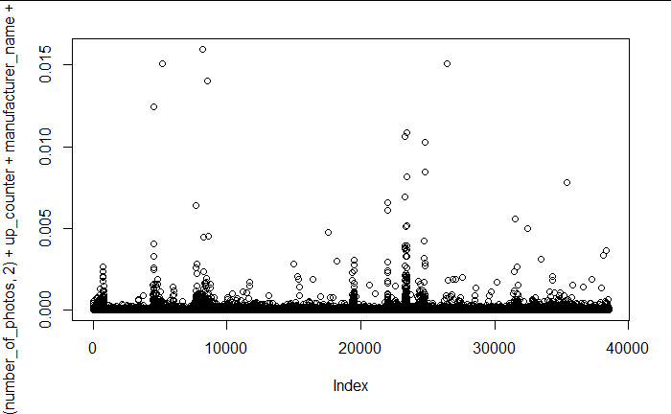
Outlier Checking for X

Slide 19
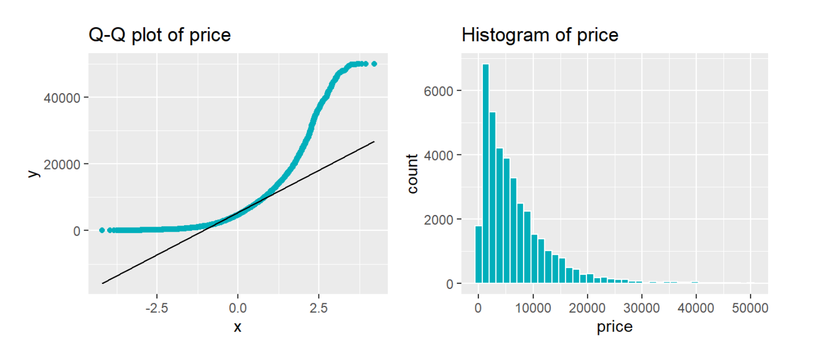
Q-Q Normalization
## One-sample Kolmogorov-Smirnov test
## D = 0.2, p-value <2e-16
## alternative hypothesis: two-sided

Slide 20
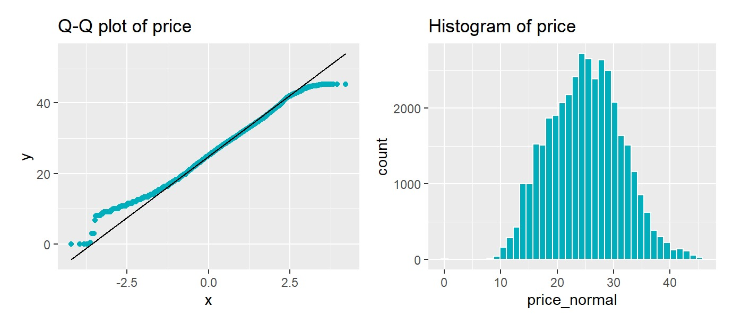
Transform the Data Normality

Slide 21
MODELING
Base Model
Polynomial Terms
Interaction Terms PLS Model
Ridge Regression

Slide 22
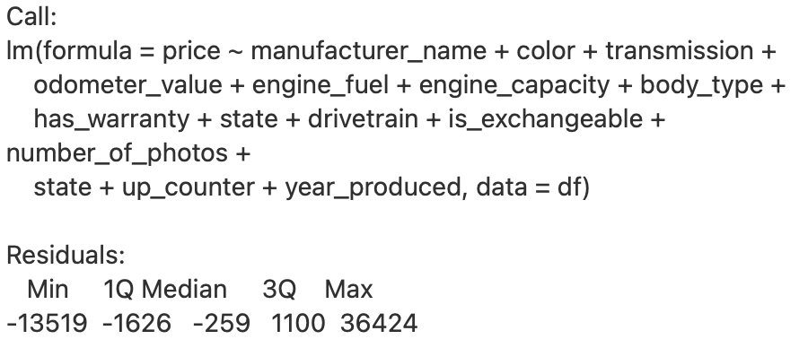
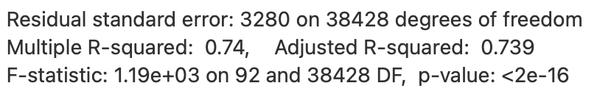
Base Model

Slide 23
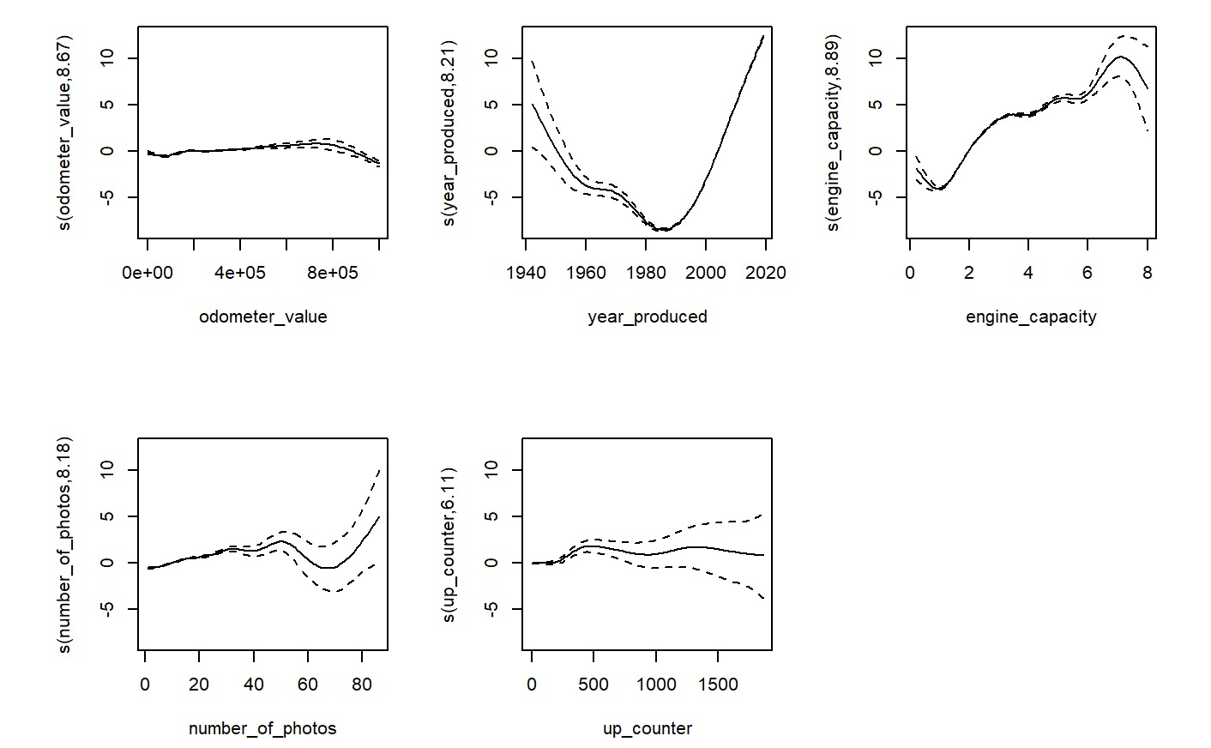
Model Polynomial Term for Continuous Variable – Generalized Additive Model

Slide 24
Polynomial Terms
lm(formula = price_normal ~ odometer_value + poly(year_produced,
2) + sin(engine_capacity) + poly(number_of_photos, 2) + up_counter +
manufacturer_name + color + transmission + engine_fuel +
body_type + has_warranty + state + drivetrain + is_exchangeable +
state, data = df)
Residual standard error: 2.2 on 38426 degrees of freedom
Multiple R-squared: 0.883, Adjusted R-squared: 0.883
F-statistic: 3.1e+03 on 94 and 38426 DF, p-value: <2e-16

Slide 25
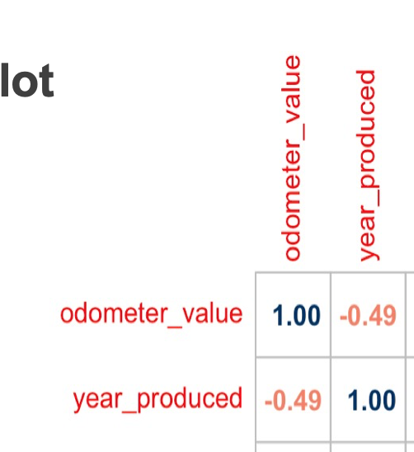

Previous Correlation Plot

Slide 26
Interaction Terms
lm(formula = price_normal ~ odometer_value * poly(year_produced,
2) + sin(engine_capacity) + poly(number_of_photos, 2) +up_counter +
manufacturer_name + color + transmission + engine_fuel +
body_type + has_warranty + state + drivetrain + is_exchangeable +
state, data = df)
Residual standard error: 2.19 on 38424 degrees of freedom
Multiple R-squared: 0.885, Adjusted R-squared: 0.885
F-statistic: 3.09e+03 on 96 and 38424 DF, p-value: <2e-16

Slide 27
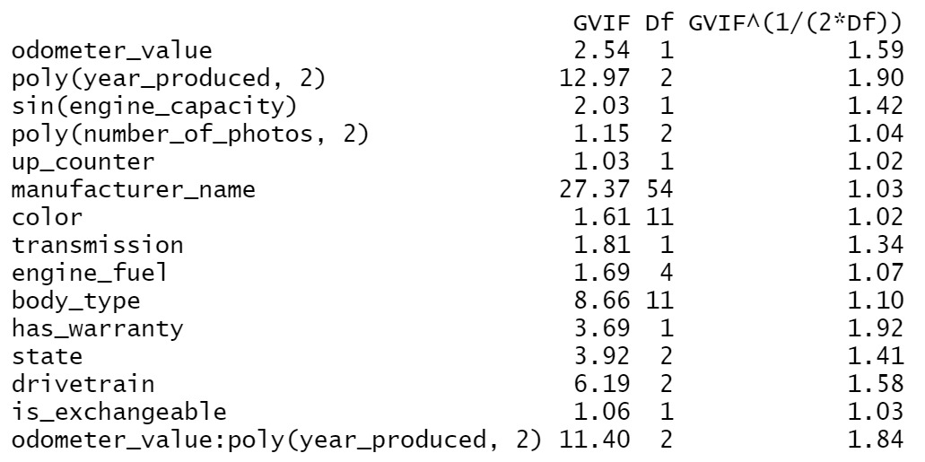
Model for Interaction Terms - VIF

Slide 28
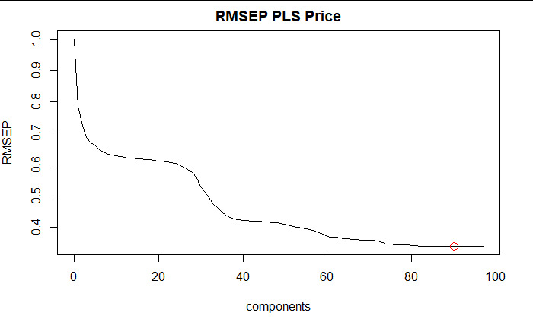
Partial Least Square Model

Slide 29
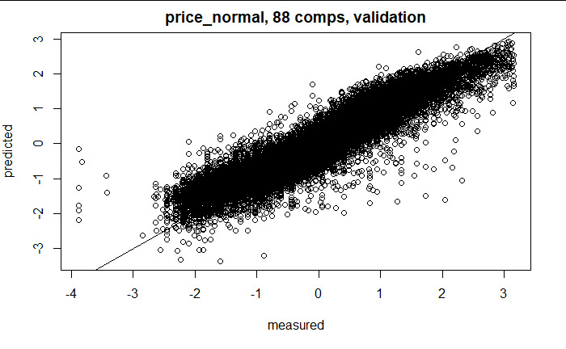
Partial Least Square Model

Slide 30
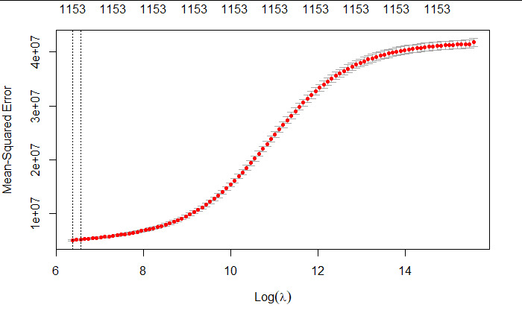
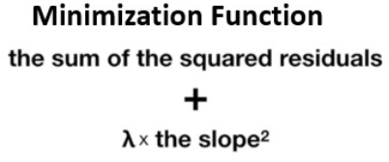
Ridge Regression
R squared = 0.94
validation MSE = 2.43
Notes:
Ridge regression: Cross validation results MSE vs log(lambda)
The first line shows the lambda at the lowest MSE

Slide 31
Conclusions

Slide 32
Prediction – What Car Does Aasish Want?
manufacturer_name ='Audi’,
model_name= 'A6’,
color='white’,
odometer_value = 46000
year_produced = 2015,
engine_fuel='gasoline’,
Predicted Price: 19,292 USD

Slide 33
Questions?

